Slide 1

TRAVELWISE
By:
Adarsh Havalad, Madhav Potturu, Ranadheer Reddy

Slide 2


MISSION STATEMENT
Our Mission is to enable every traveller with a digital partner to fulfil vacation dreams through our personalized itinerary recommendation, world class accommodation services and customized budget trips.

Slide 3






VALUE PROPOSITION
• Personalized Itinerary system
• Customization of travellers ongoing trip
• Providing the best in class accommodation and transportation services
• Providing tour guides packages along with a recommended itinerary
• Constant customer support throughout the travel

Slide 4
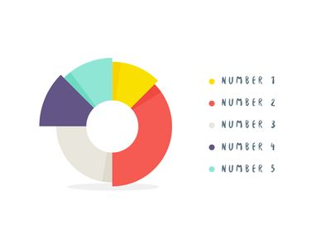

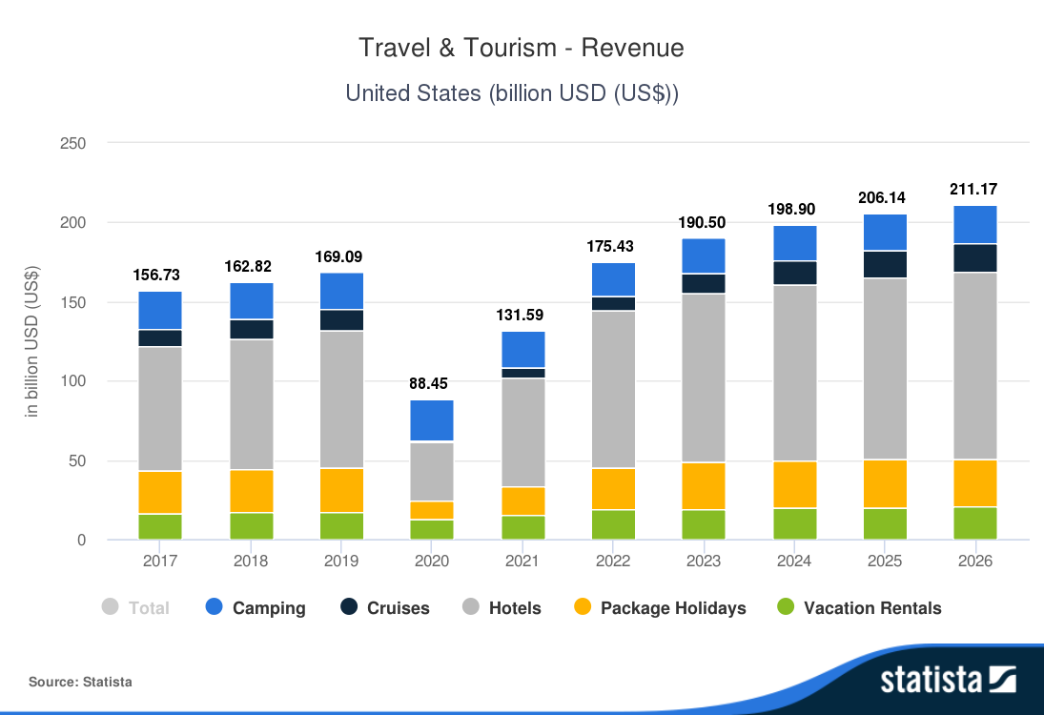


MARKET SIZE AND CUSTOMER SEGMENT
Unites States Tourism Revenue

Slide 5

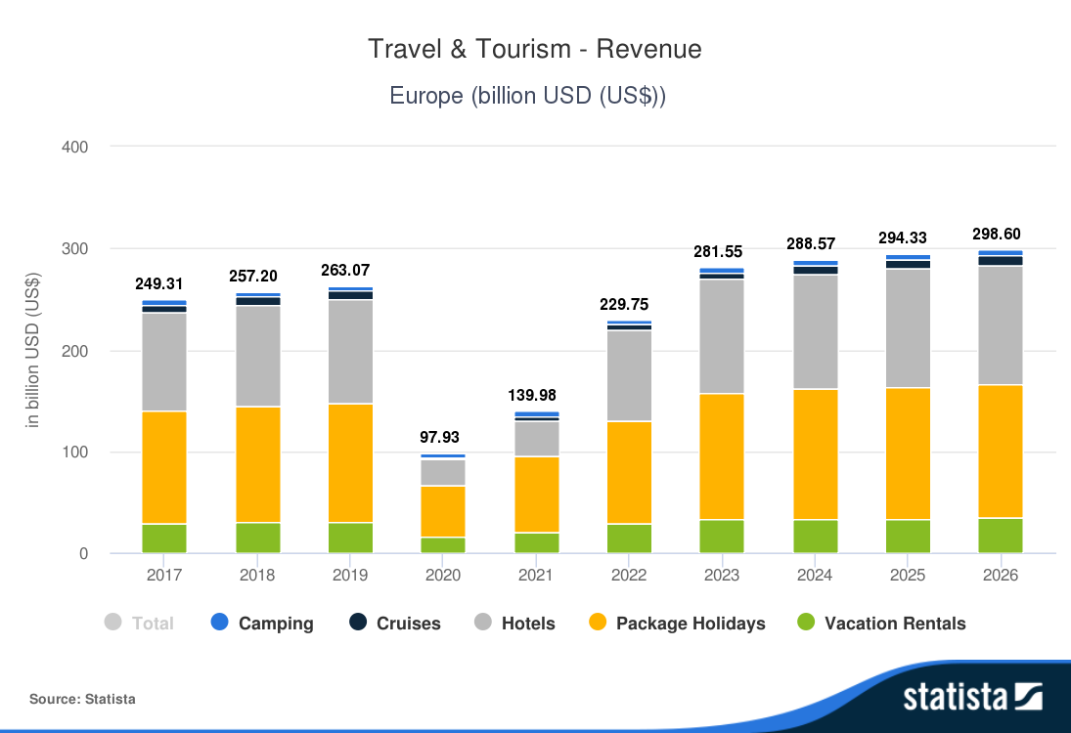
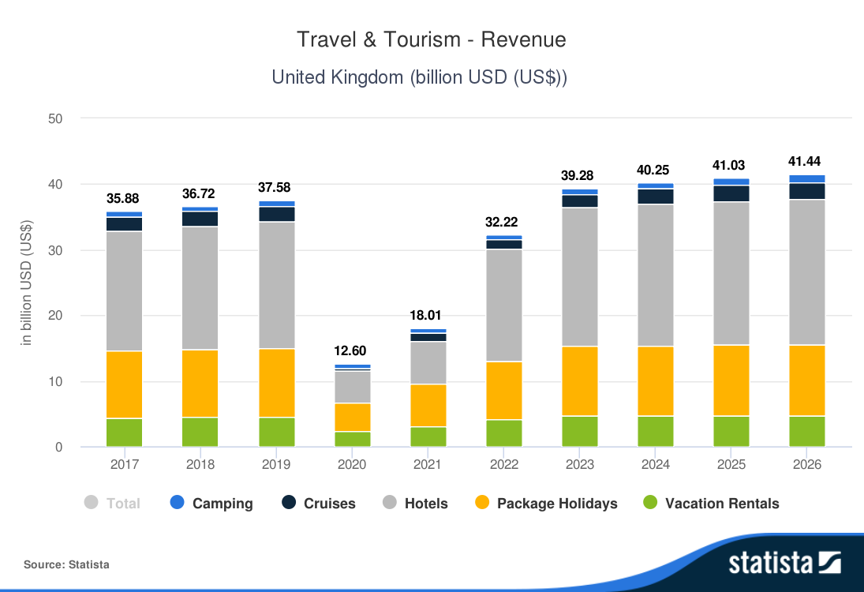
MARKET SIZE AND CUSTOMER SEGMENT
Europe Tourism Revenue
United Kingdom Tourism Revenue

Slide 6
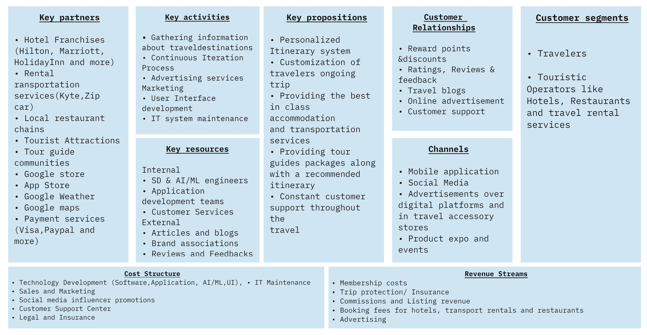
CANVAS BUSINESS MODEL

Slide 7

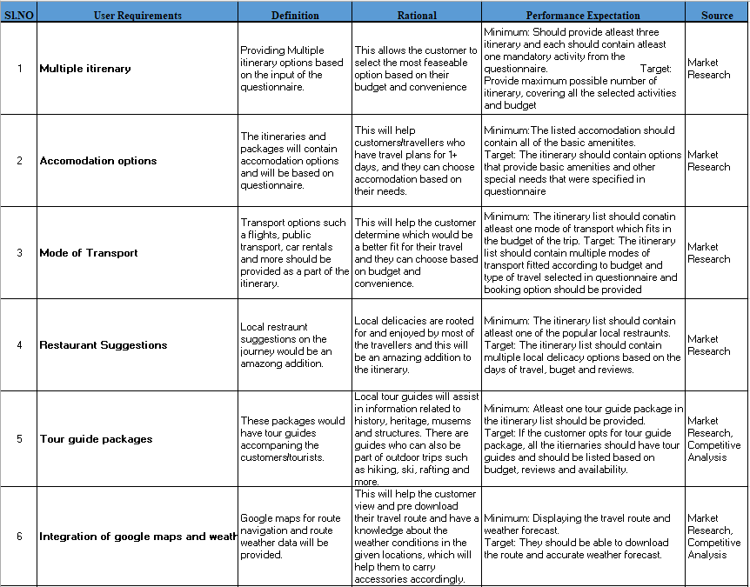
FUNCTIONAL SPECIFICATIONS

Slide 8
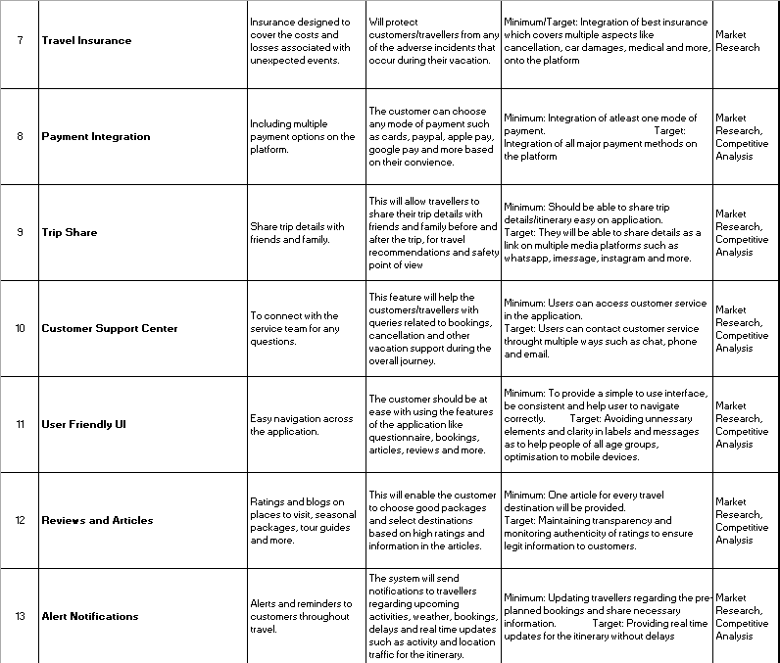
FUNCTIONAL SPECIFICATIONS

Slide 9


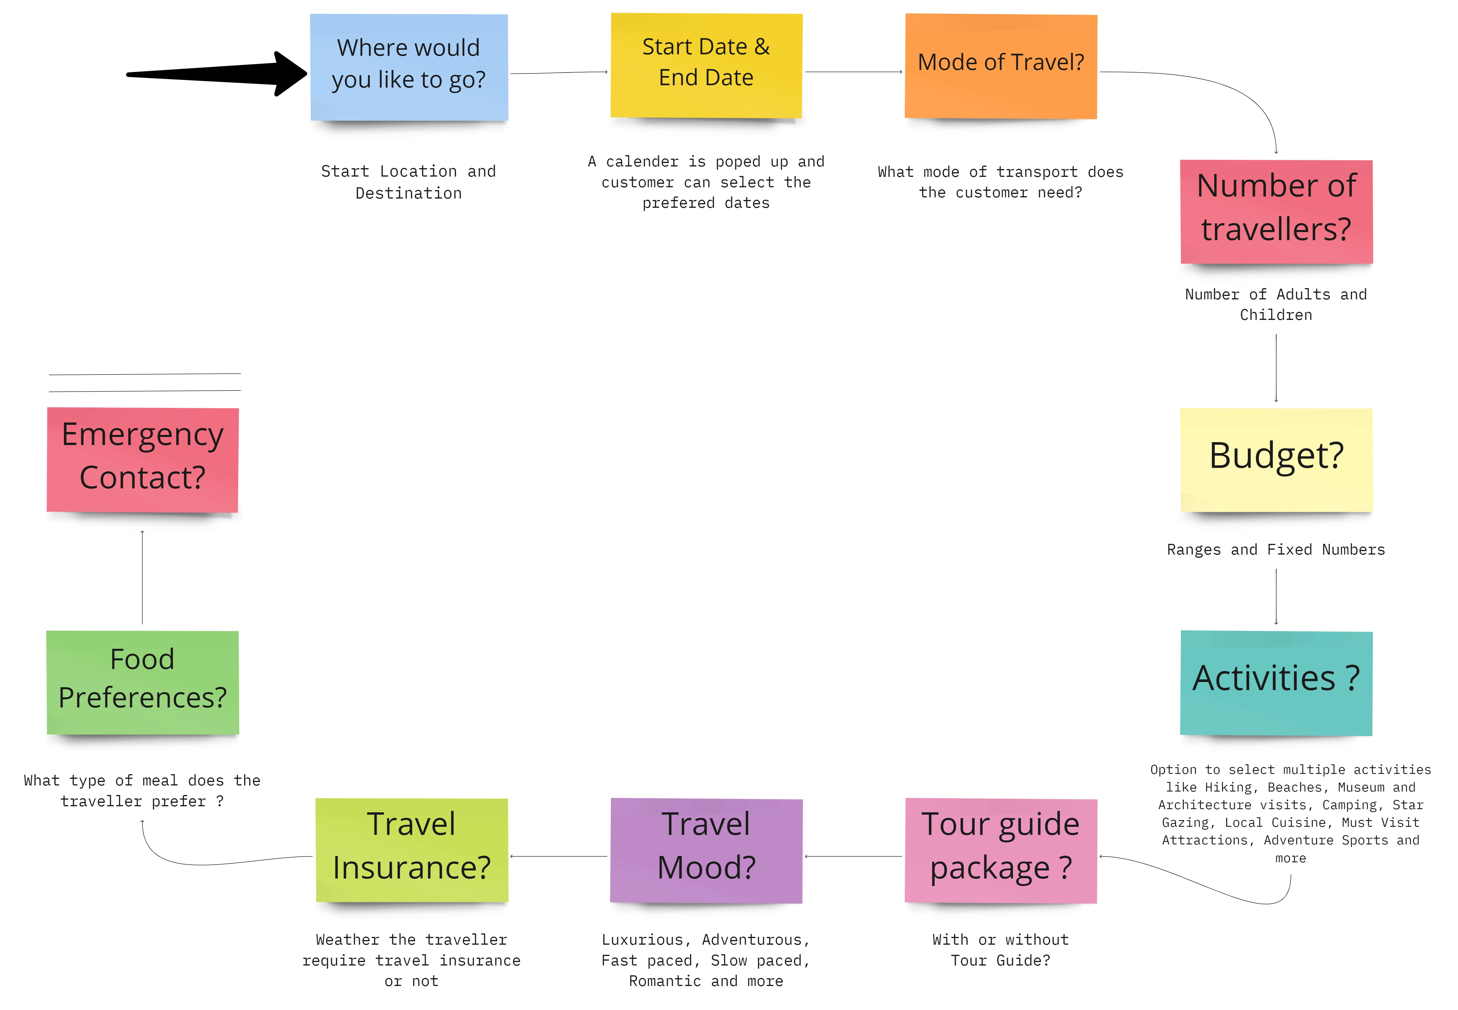

QUESTIONNAIRE

Slide 10



REVENUE STREAMS
Commission and Booking Fee
Paid Membership
Advertising
Trip Insurance

Slide 11

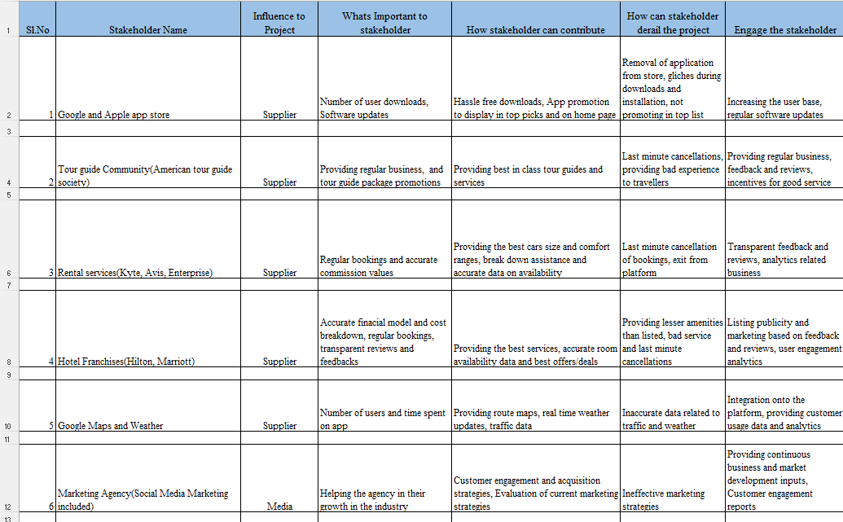
STAKEHOLDER MATRIX

Slide 12
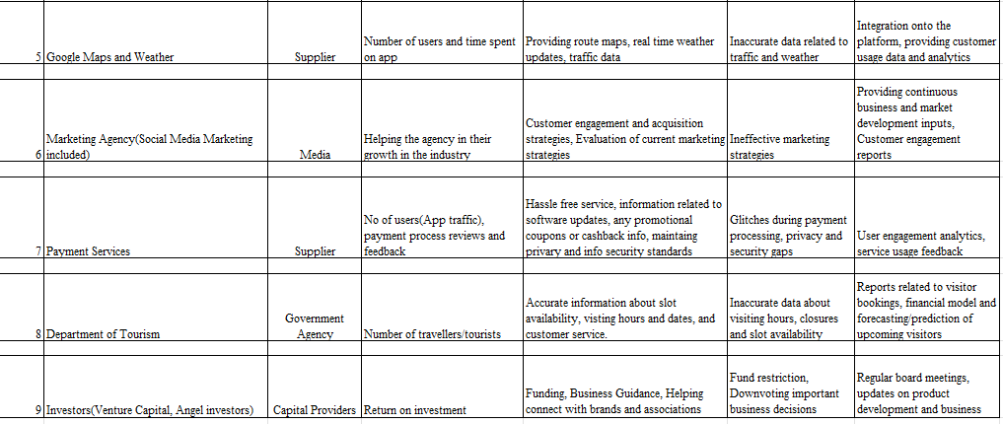
STAKEHOLDER MATRIX

Slide 13
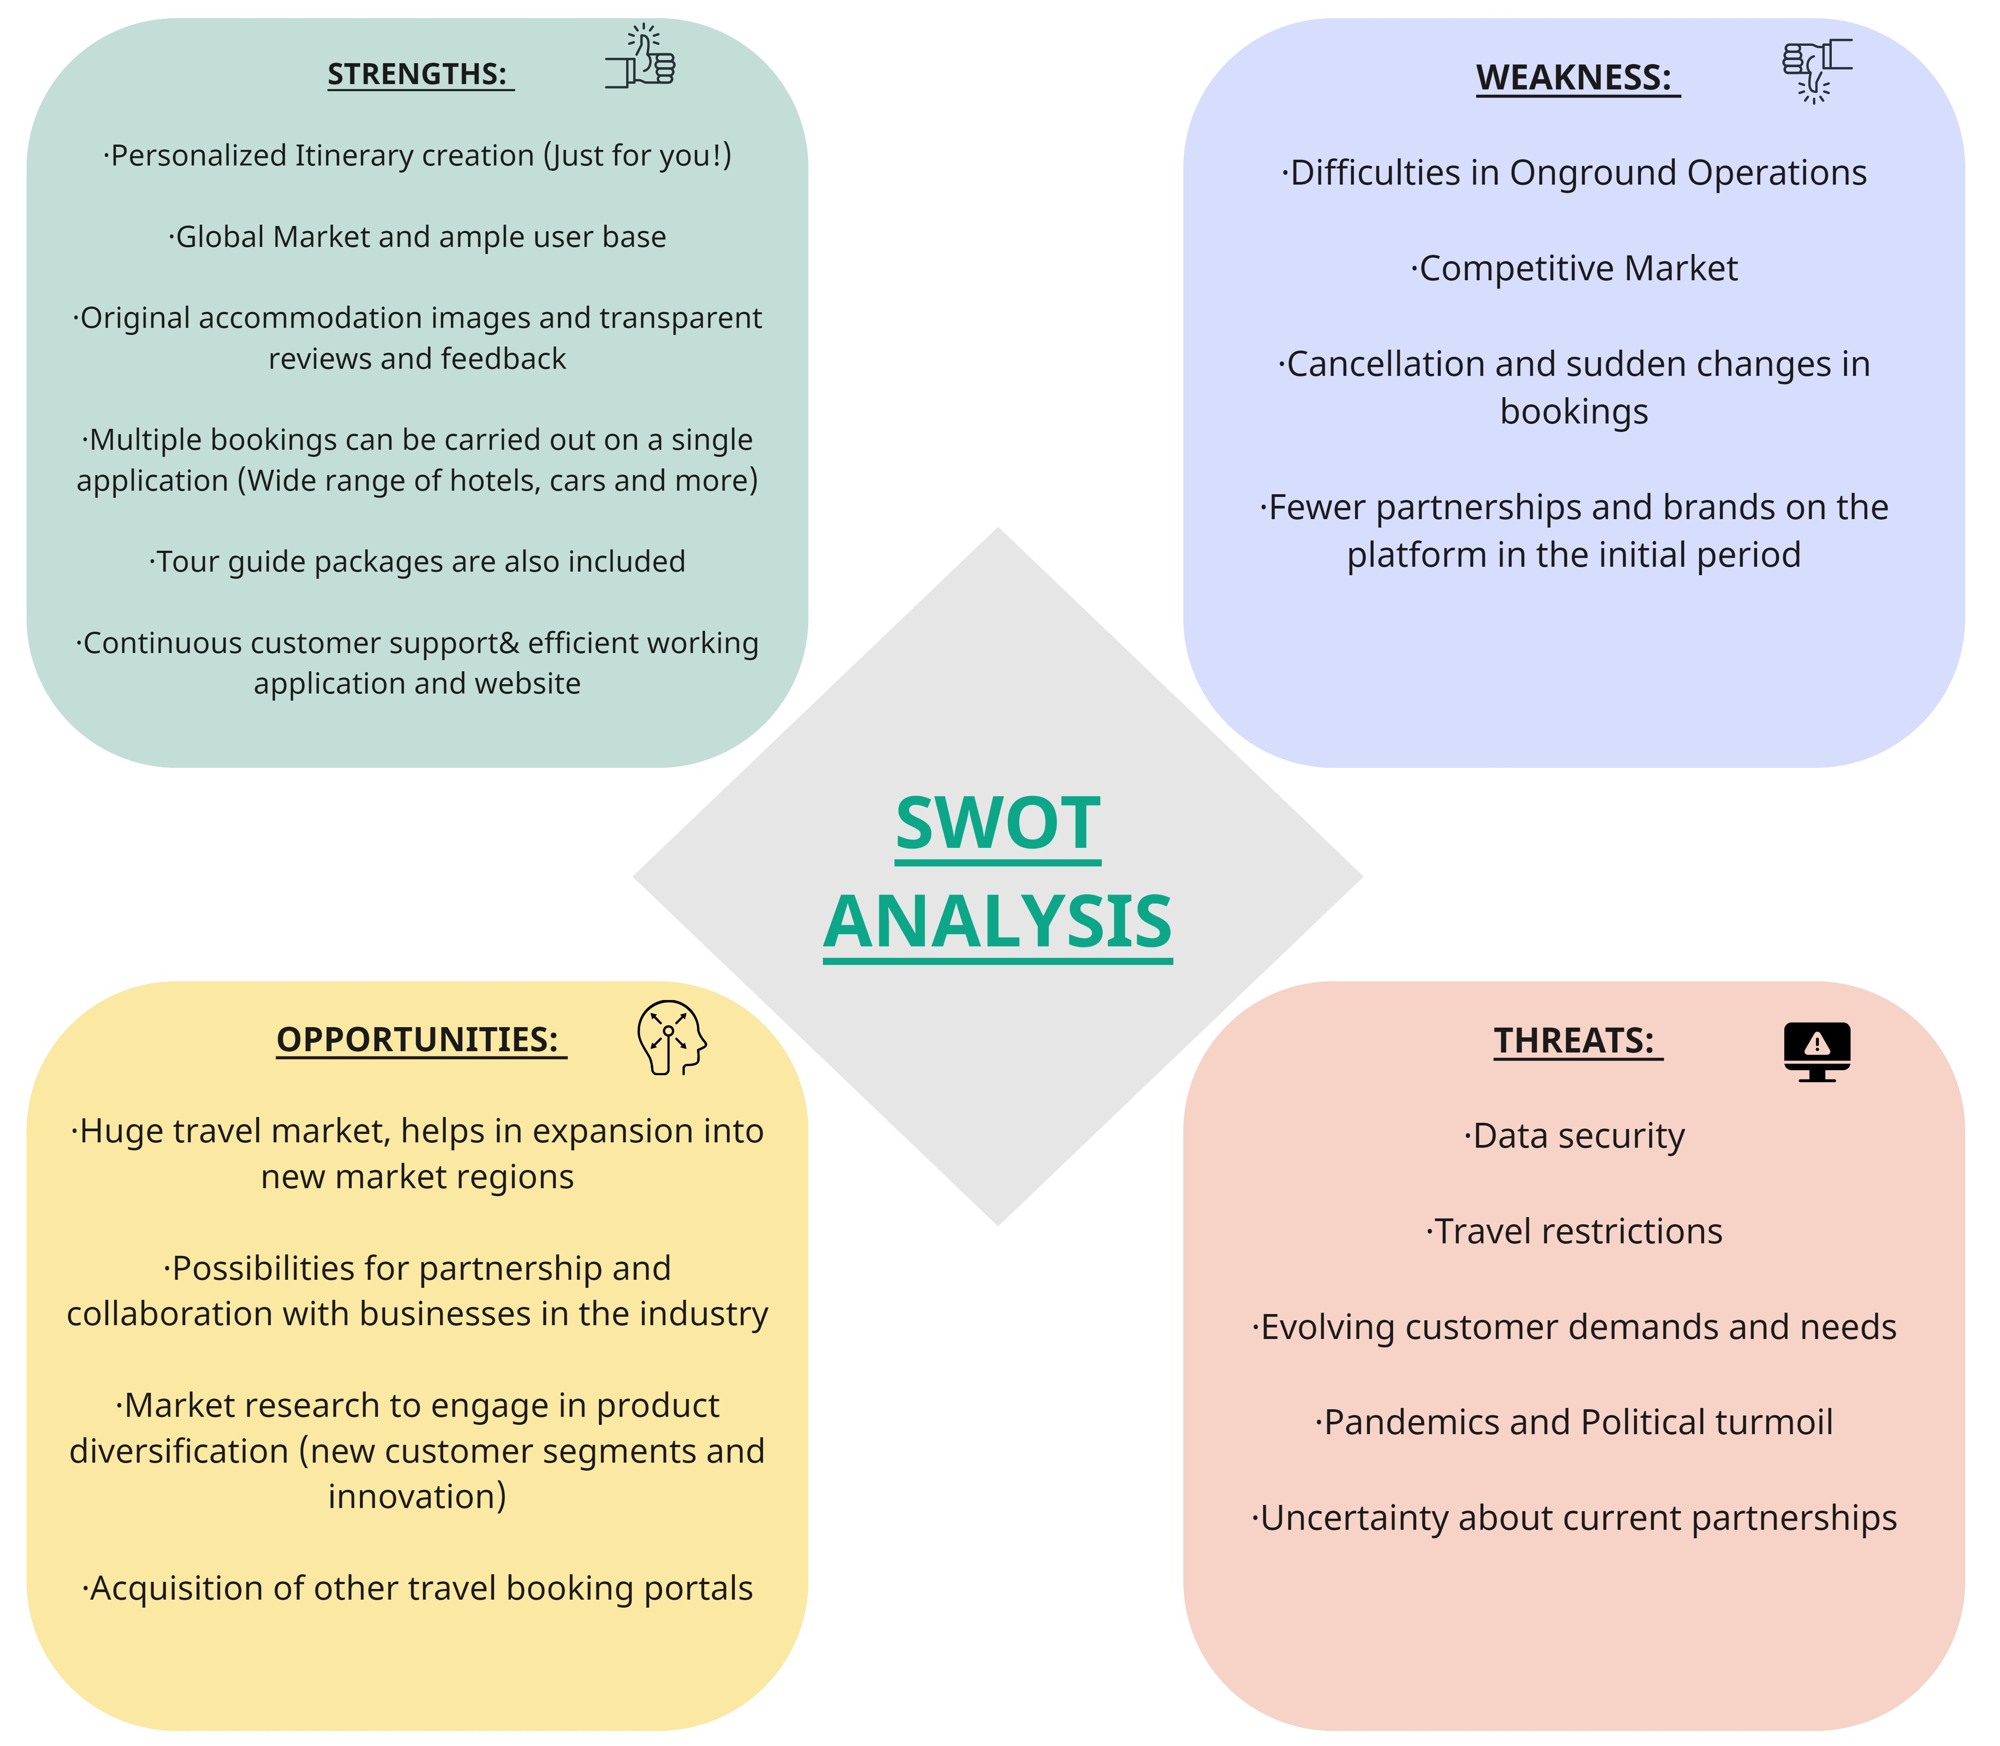

Slide 14


